Slide 1
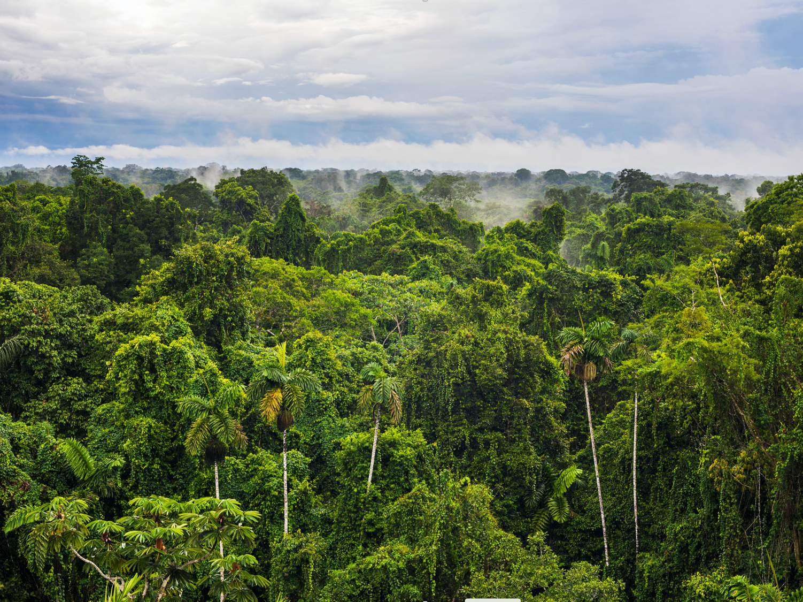
On the use of Earth observation data for auditable nature-based solutions
Gilberto Camara
https://gilbertocamara.org
image: Alamy

Slide 2
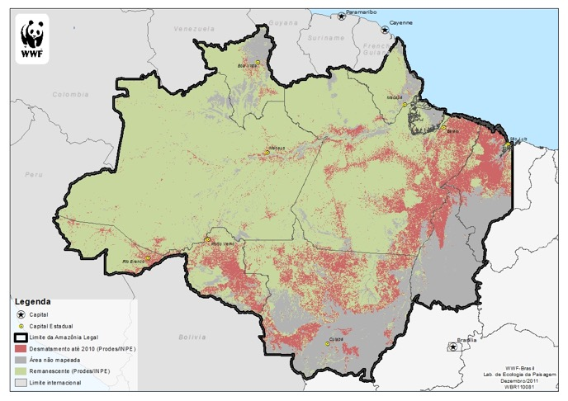
The value of Earth observation: How much? Where? When? Who?

Slide 3
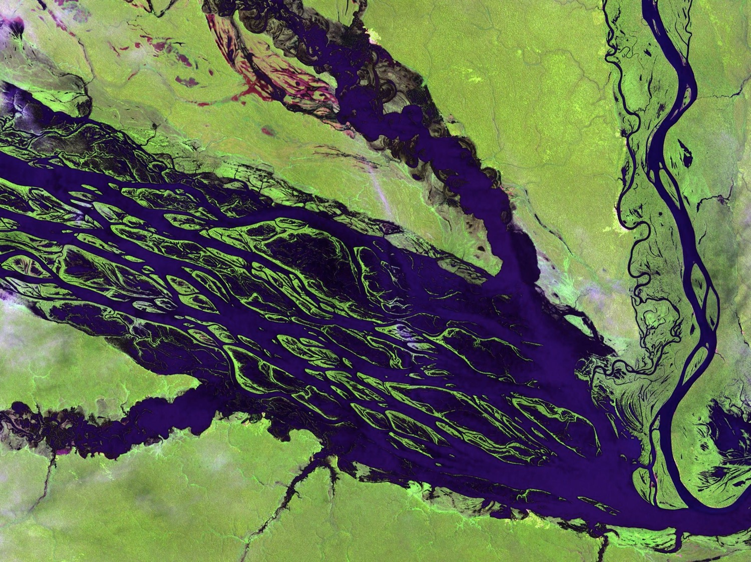
Questions from Shell
What is currently already possible with satellites and what can be expected in the next few years?
What are opportunities for Earth Observation in future reporting, and where are the gaps which need to be addressed?
How do you see the future of tax-payer funded programs vs commercial initiatives?
What are the advances required in S&T support global (and Shell’s) ambitions to deploy auditable nature based solutions?

Slide 4
The age of big Earth observation data
Terra
Sentinel-1/1A
Sentinel-2/2A
Landsat-8
Sentinel-3
CBERS-4/4A

Slide 5
Optical Satellites for Forestry and Agriculture
100
50
CBERS-MUX
Forestry
Mapping
Land Use
Agriculture
LANDSAT
Revisit (days)
10
Deforestation
Detection
5
Sentinel 2A/2B
CBERS-AWFI (4/4A)
Amazonia-1
MODIS
1
1
Planet
5
10
50
100
500
1000
Resolution (meters)

Slide 6
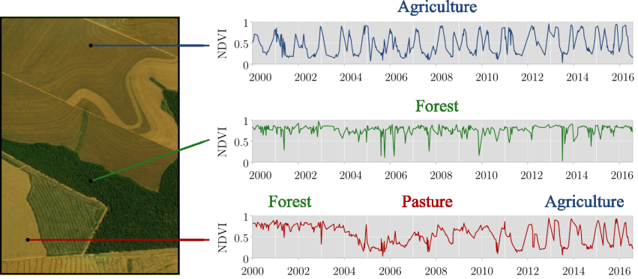
Continuous monitoring of landscapes
Transformations of land cover due to actions of land use
graphics: Rolf Simoes (INPE)

Slide 7
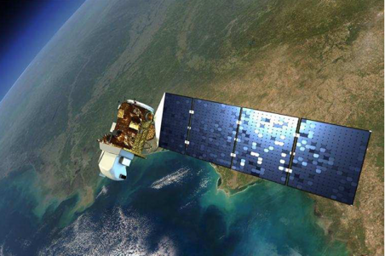
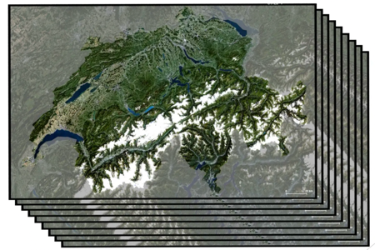
Big EO data for sustainable development
Big satellite data
(2PB per day)
Data cubes
(consistent observations)
Machine learning
(classification)
In what ways is big spatial data special?
images: NASA, Swiss Data Cube, ECMWF

Slide 8
What are the limits of machine learning?
What works for face recognition, automatic translation, and Chess/Go games does also work for big spatial data?
image: manmax31.github.io

Slide 9
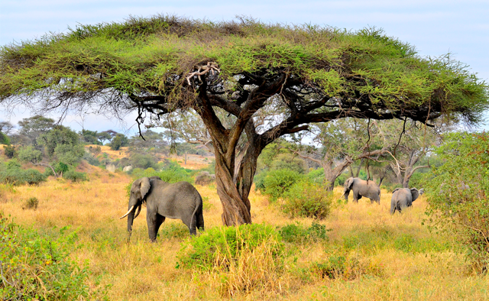
The elephant in the room
The Elephant in the savanna
Big satellite data
Data cubes
Machine learning
Ecosystems are highly variable
Local knowledge is essential
images: Alamy, NASA, Swiss Data Cube, ECMWF

Slide 10
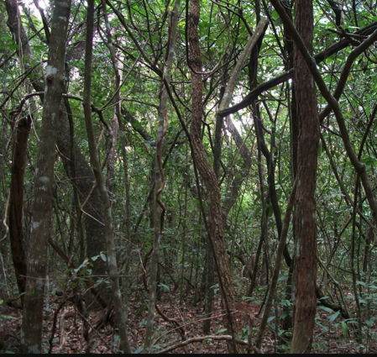
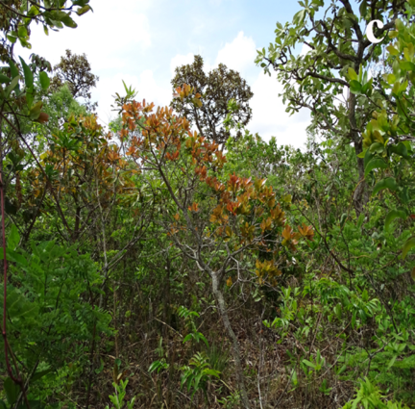
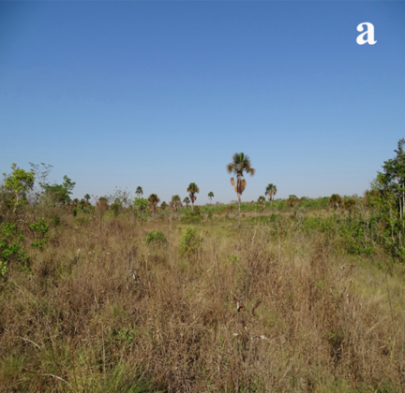
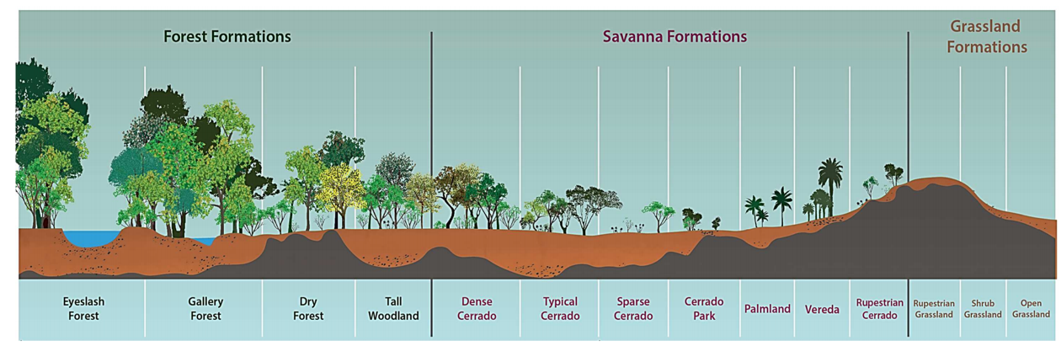
Cerrado: Brazilian savanna
Cerradão (woodland)
Cerrado strictu sensu
Open cerrado
images: Del-Claro and Silingardi (Annals Brazilian Academy Sci, 2019 )

Slide 11
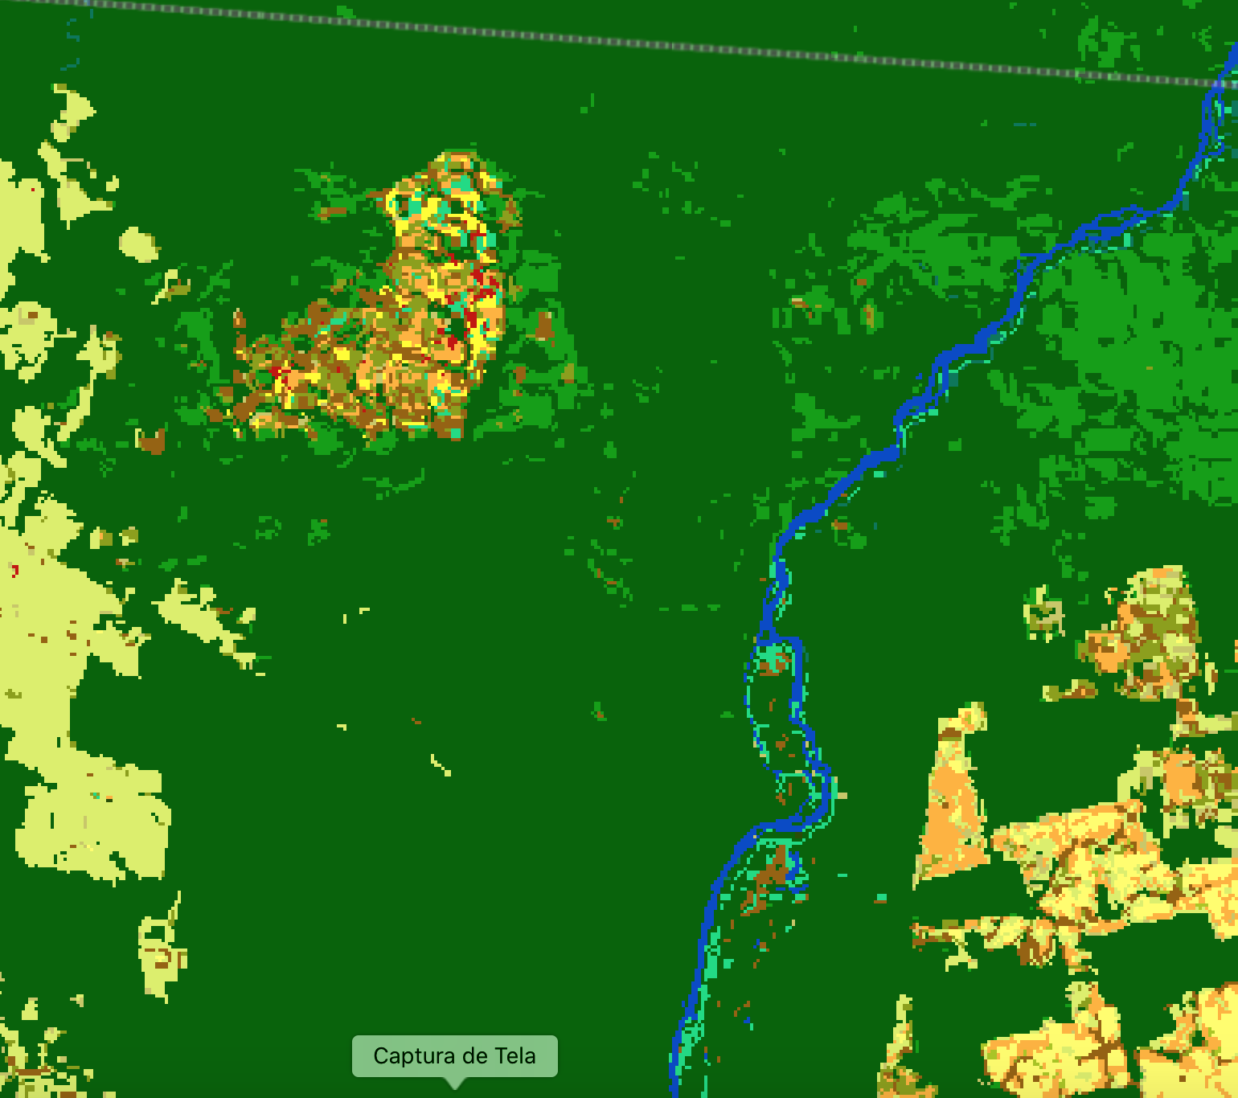
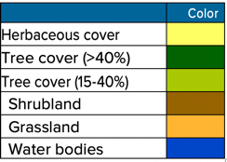
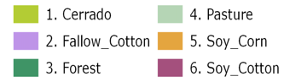
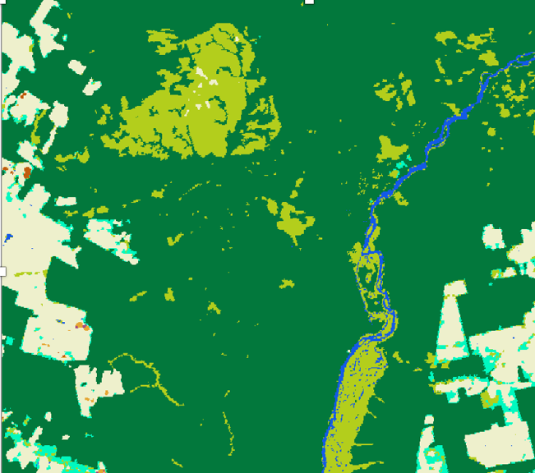
Limitations of global maps
ESA CCI (no distinction btw
shrublands and pasture)
INPE’s new map (distinction btw
Cerrado and pasture)
Co-design is essential for auditability

Slide 12
Questions from Shell
What is currently already possible with satellites and what can be expected in the next few years?
What are opportunities for Earth Observation in future reporting, and where are the gaps which need to be addressed?
How do you see the future of tax-payer funded programs vs commercial initiatives?
What are the advances required in S&T support global (and Shell’s) ambitions to deploy auditable nature based solutions?

Slide 13
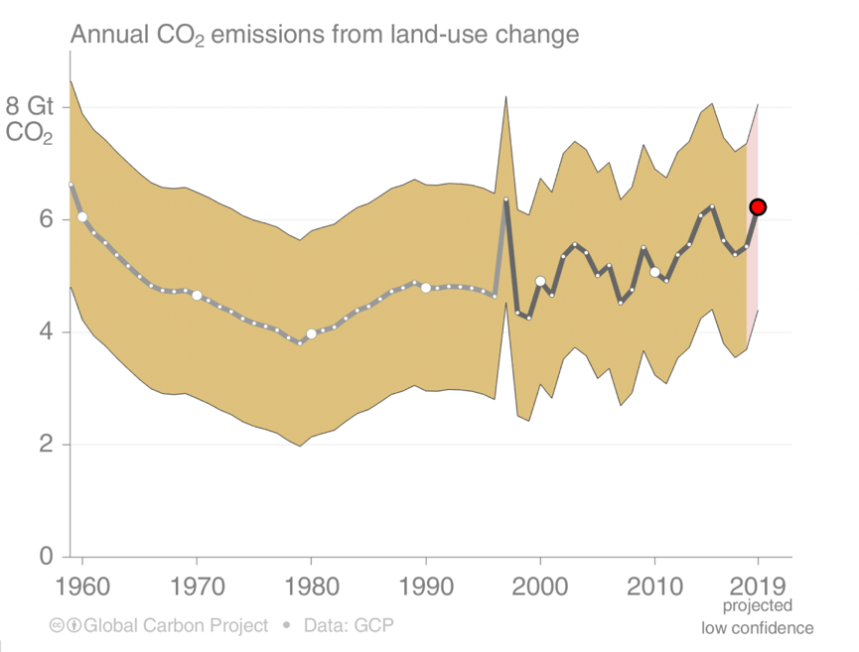
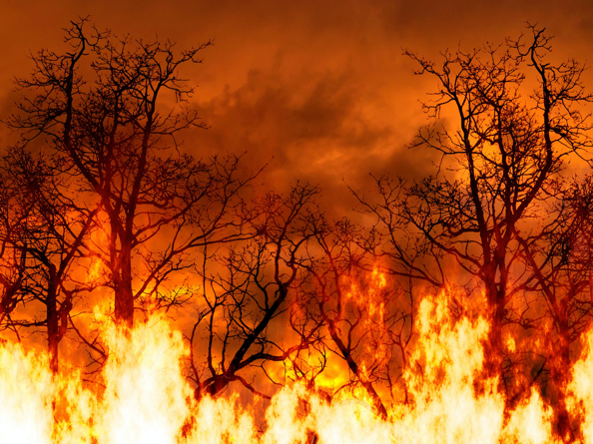
Land use change emissions
Land-use change emissions are highly uncertain, with no clear trend in the last decade.
source: Global Carbon Project

Slide 14
The Paris Agreement
National measures (NDC + NAP)
Progress reports every 2 y
INTERNATIONAL LEVEL
Limit global warming
Adapt to a low-carbon economy
Finance green growth
Revision of national measures
Global stocktake (2023 => every 5 y)
IPCC assessments
NATIONAL LEVEL
Recommendations
Source: Joanna Post (UNFCCC)
Notes:
The Paris Agreement is the main international climate change treaty;
It‘s goals are: 1. keep global warming below +2 C, or preferably +1.5 degrees;
2. to enhance ability to adapt to changes;
increase resilience, and increase finance flows in the context of sustainable development
To reach these goals, the Paris Agreement outlines a „cycle“:
Top left: countries provide a national climate target every 5 y; they are „nationally determined“, but must be stronger than the previous targets; Communicated individual efforts every 5 years
Starting in 2024 countries will report on progress – and reporting will take place every 2 years Every 2 years, countries report on emissions; reporting is more flexible for developing countries, but all should move towards stricter reporting over time;
A globalstocktaking happens every 5 y to consider:
implementation;
2. collective progress towards the goals; for adaptation: progress towards adaptation goal and adequacy and effectiveness of adaptation action
3. The stocktaking recommends ways to be more ambitious in the next cycle;
Countries take the recommendations and their experiences home, and then, provide more ambitious targets in the next 5 year cycle.
Transparency to build trust and confidence:
GHG Inventory
Progress on NDCs
Support provided
Support needed and received
Adaptation
L&D
In the Paris Agreement Article 14 The Global Stocktake, Parties agreed to measure collective progress towards achievement of the Paris Agreement goals: mitigation, adaptation, and the means of implementation and support. At the first meeting of the Conference of the Parties serving as the meeting of the Parties to the Paris Agreement (CMA) in 2018, Parties further decided that the global stocktake (GST) may also consider efforts on the social and economic consequences of response measures and averting, minimizing and addressing loss and damage.
Opportunities for observation / data community to support the work of the GST – directly to Parties and to global process under UNFCCC

Slide 15
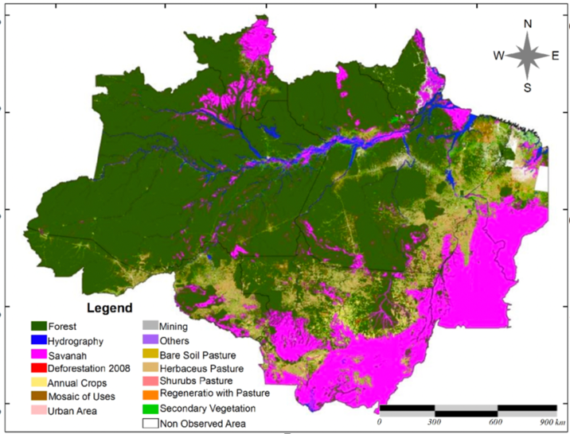
Auditable land use emission accounting
Emissions = land-use change * biomass * emission factor
Big data analytics
BIOMASS satellite

Slide 16
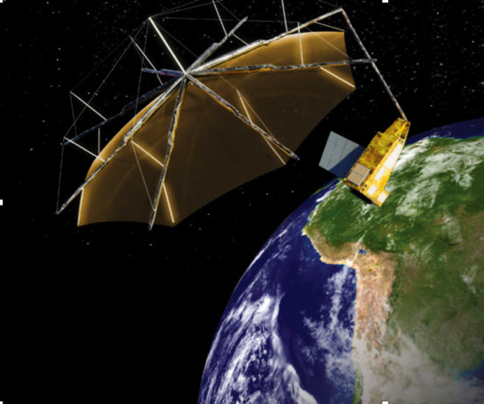
European Space Agency BIOMASS mission
P-band satellite
maps of forest biomass and forest height at a resolution of 200 m
Launch in 2021 – Data and results will be open
Greatly improved modelling of terrestrial carbon cycle
Gridded high-resolution global estimates of above ground biomass

Slide 17
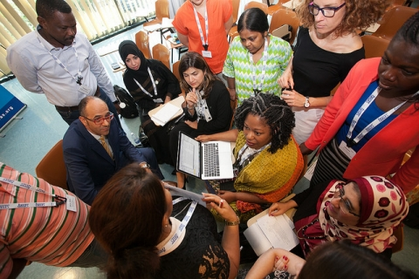

Auditable country reporting requires trust
co-design, co-production
Trusted, auditable results
EO data

Slide 18
Questions from Shell
What is currently already possible with satellites and what can be expected in the next few years?
What are opportunities for Earth Observation in future reporting, and where are the gaps which need to be addressed?
How do you see the future of tax-payer funded programs vs commercial initiatives?
What are the advances required in S&T support global (and Shell’s) ambitions to deploy auditable nature based solutions?

Slide 19
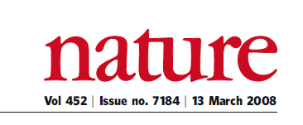
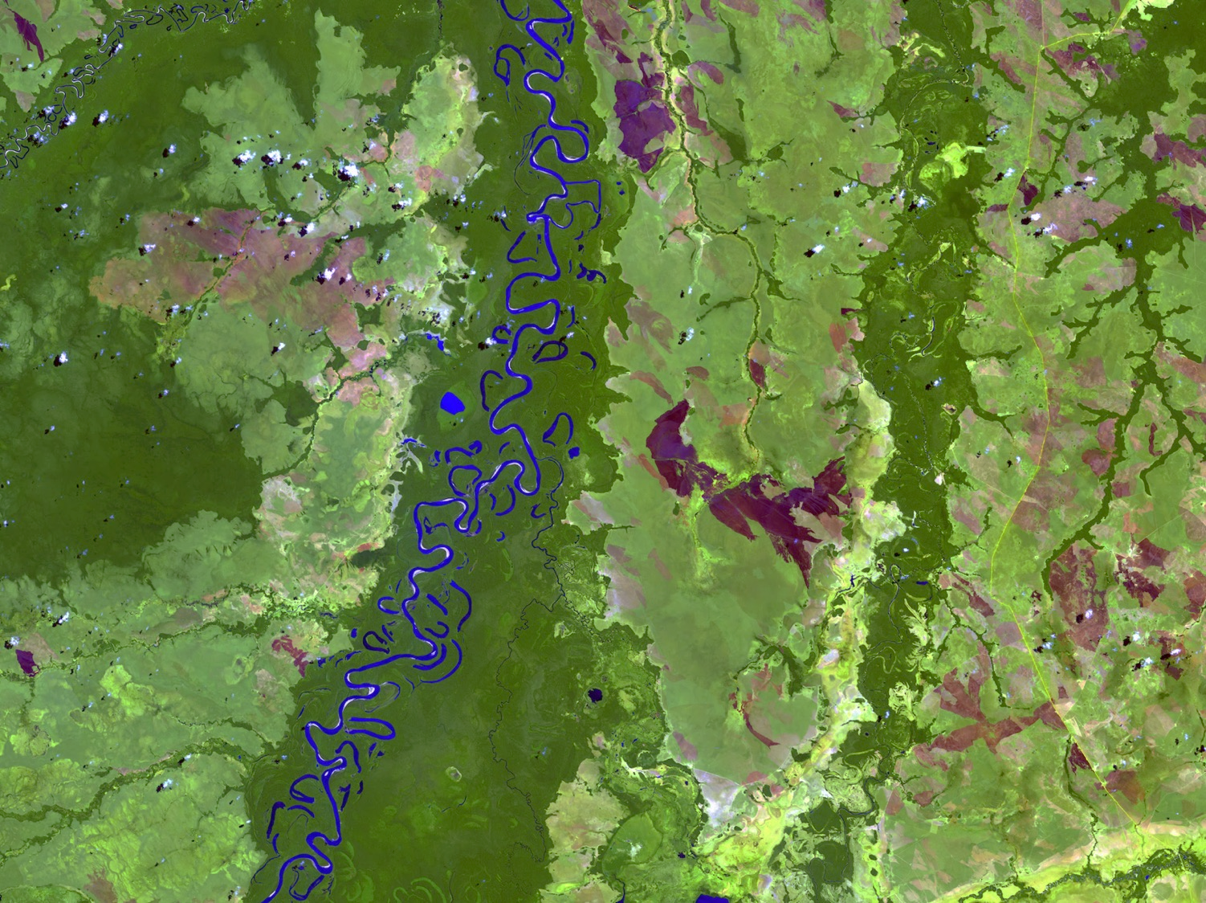
“A few satellites can cover the entire globe, but there needs to be a system in place to ensure their images are readily available to everyone who needs them. Brazil has set an important precedent by making its Earth-observation data available, and the rest of the world should follow suit.”

Slide 20
Where does the value of EO come from?
Rosetta – the comet chaser
Copernicus – Earth chaser
Open public data is essential for reproducibility and auditability

Slide 21
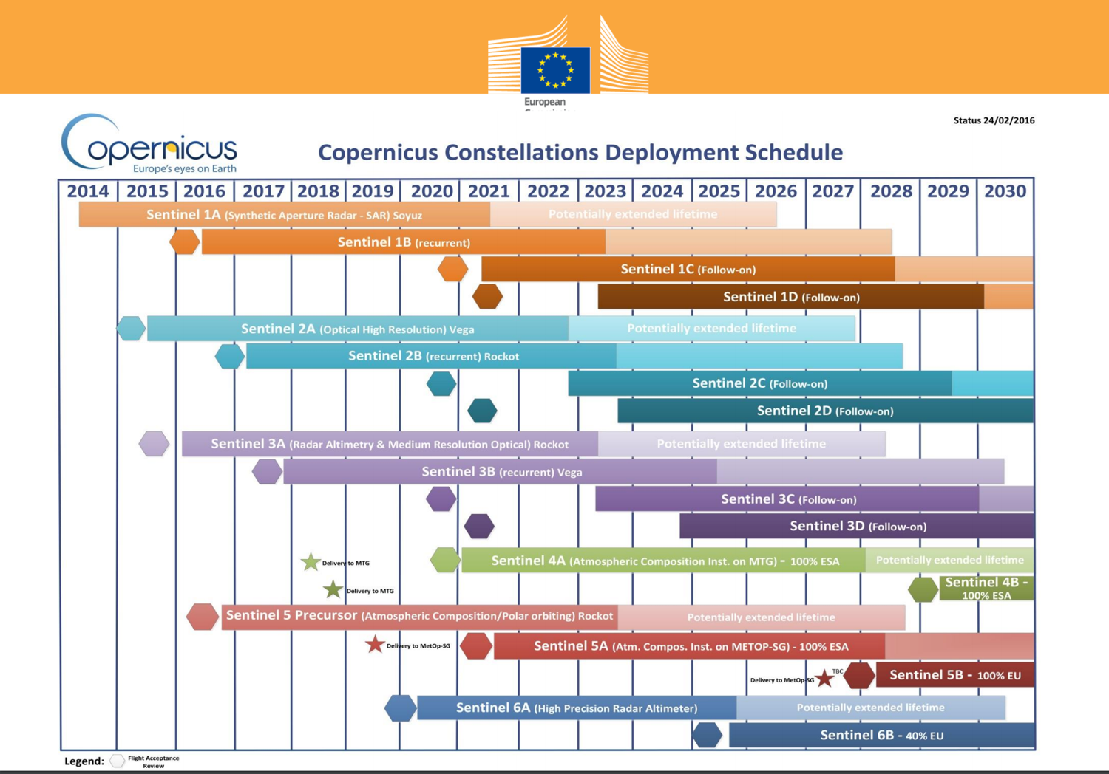

Slide 22
Questions from Shell
What is currently already possible with satellites and what can be expected in the next few years?
What are opportunities for Earth Observation in future reporting, and where are the gaps which need to be addressed?
How do you see the future of tax-payer funded programs vs commercial initiatives?
What are the advances required in S&T support global (and Shell’s) ambitions to deploy auditable nature based solutions?

Slide 23

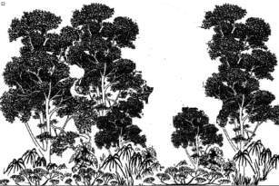
Potential for CO2 sink in Amazonia: Brazil’s NDC
Clear-cut areas
12,000,000 ha (15% of deforested area)
5 Gt CO₂eq (2020-2030)
Forest (biomass after 10 years)

Slide 24


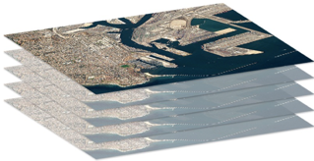
Advances required for auditable nature-based solutions
Empowered institutions
Reusable, shared knowledge
Open cloud platforms
Building blocks of a digital ecosystem for the environment

Slide 25
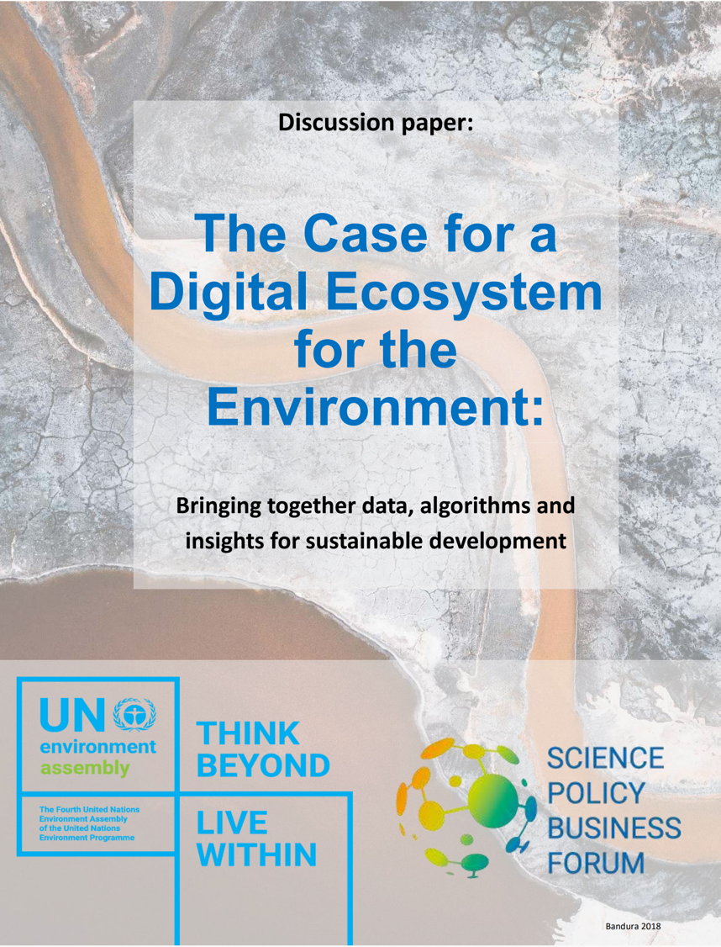

Slide 26
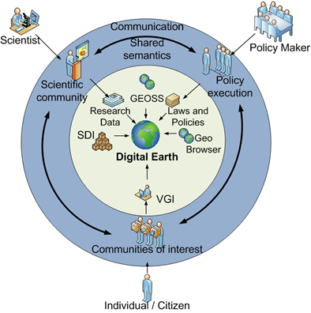
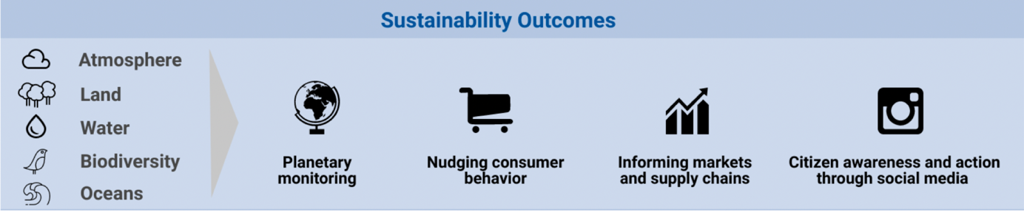
Developing a shared global solution
Could Shell contribute to a global public good solution?

Slide 27
Concluding thoughts
What is currently already possible with satellites and what can be expected in the next few years?
Big EO data analysis can improve land use assessments, but need advances in hybrid ecological-statistics models.
What are opportunities for Earth Observation in future reporting, and where are the gaps which need to be addressed?
EO can improve UNFCCC reporting, but countries need empowerment to produce them.
How do you see the future of tax-payer funded programs vs commercial initiatives?
Open public programs are essential for global transparency.
What are the advances required in S&T to support global (and Shell’s) ambitions to deploy auditable nature based solutions?
Open Science: accessible cloud services with reproducible knowledge.

